Slide 1

Manager of Contacts

Slide 2
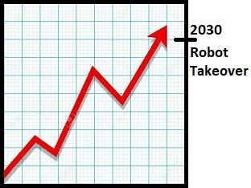
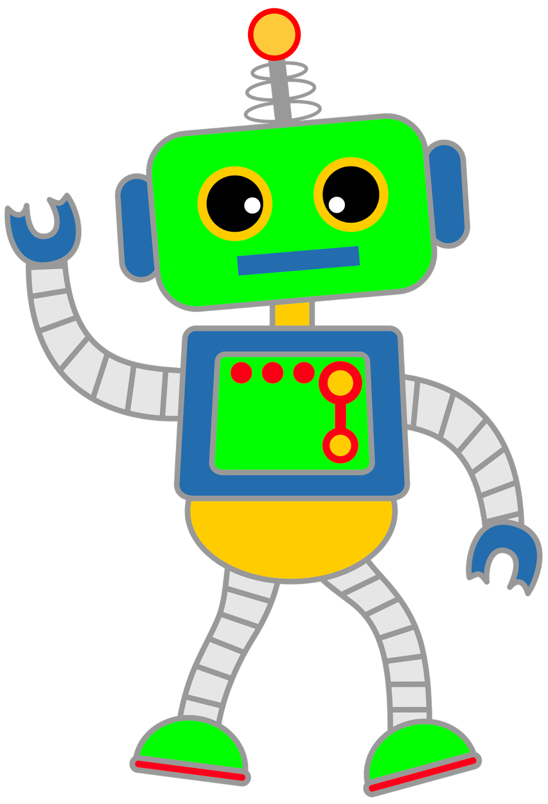
Contact Manager for Robots

Slide 3

Team Members
Andrew Nicely
Project Manager
API/Front-End
Vincent Barone
Front-End
Presentation
Ran Xu
API
Debugger
Junejae Kim
API
Database
Server Deployment

Slide 4
MERN Stack
MongoDB
Express.js
React
Node.js

Slide 5
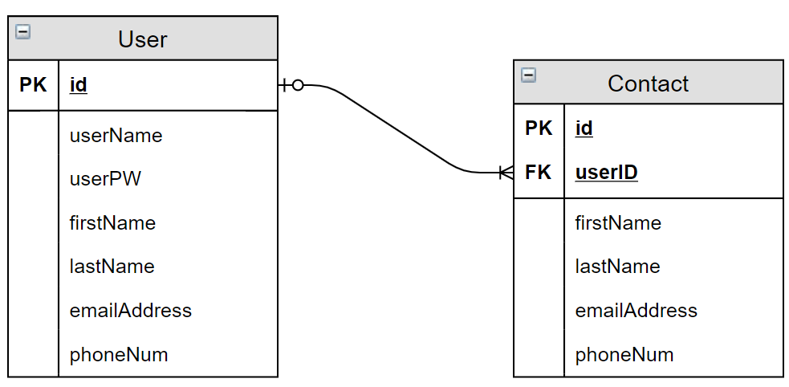
Entity Relationship

Slide 6
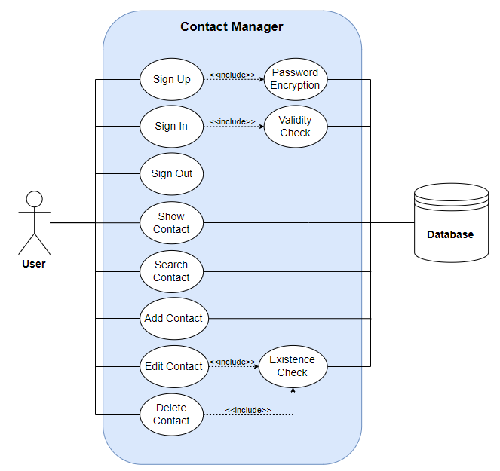
Use Case

Slide 7
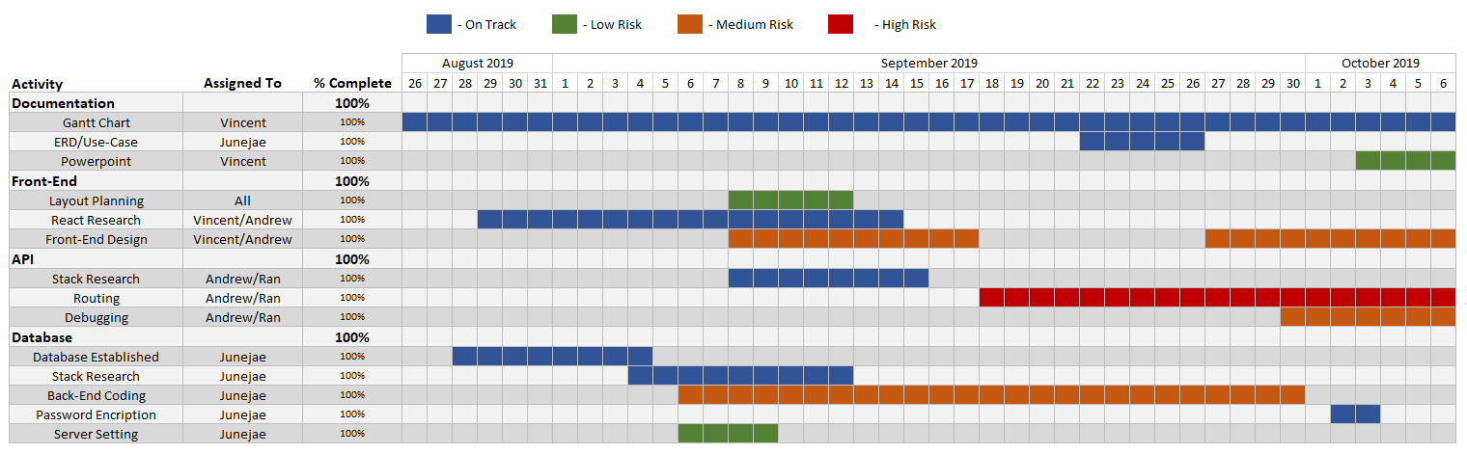
Gantt

Slide 8


What went well? What did not?
Weekly meet-ups
Prior experience with MERN
High knowledge absorption
Unable to connect to front-end
Front-end redesign required
React

